Slide 1
Backup for MeeGo
BoF – 16th November 2010
Sateesh Kavuri
Ouyang Qi
Otso Virtanen

Slide 2

BoF setup
Introduction to the area
Q&A/interactive part

Slide 3
Contents
Maemo solution for B&R
B&R for MeeGo
  Use cases
Architecture
API for developers
Inputs/proposals

Slide 4


Maemo solution for B&R
Default locations (parts of /MyDocs, gconf etc.)
  Application specified locations in XML
Dbus signals
Zip files generated
Scripts after restore
Device resident backup created – user needs to actively transfer away from the device
http://wiki.maemo.org/Documentation/Maemo_5_Developer_Guide/Generic_Platform_Components/Using_Backup_Application

Slide 5


Slide 6
B&R for MeeGo
Target use cases:
  I loose my MeeGo device – with B&R I can get a new device the same as the one I lost
  I do not need to start the backup manually – after switching it ”ON” it just works
Fulfilling the above:
  Requires incremental approach
  Must be possible to backup to cloud
Must be agnostic to the target repository

Slide 7
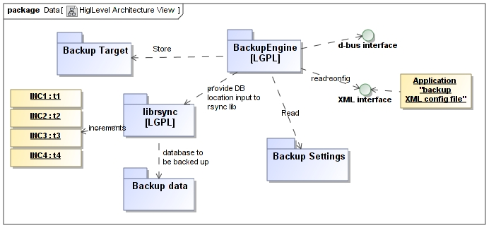
Architecture

Slide 8
API for developers
Specific locations, Tracker db, gconf included by default
  XML format for developers to specify their backup locations
dbus signals for serializing in-memory contents during backup

Slide 9
Roadmap
MeeGo 1.2
  Project started – command line tool for device resident backup
MeeGo 1.3
  Online backup
Featurezilla requirements available partly
Git repository requested
Bugzilla component requested
http://wiki.meego.com/Branta

Slide 10

Inputs/Proposal
Food for thought:
  Big data (images, videos)
  Individual file rescue, data categories
  Online backup destinations

Slide 11

Thank you!
&
Discussions!

